Slide 1
Recursion Presentation
by Paul Chafetz

Slide 2
What is Recursion?
Recursion is the technique of repeating a set of actions within the action itself.
To use recursion in a practical sense, you must analyze the problem and break it into smaller problems that can be solved.
If you can solve all these smaller problems, you would also solve the initial, larger problem! That’s the power of recursion at play.

Slide 3

Divide and Conquer
“Divide and Conquer” is the key to solving recursive problems.
This method works by dividing a large problem into multiple sub-problems and conquering each sub-problem individually.
Not only is this extremely efficient, but sometimes, it may be the only way to get the job done right.

Slide 4
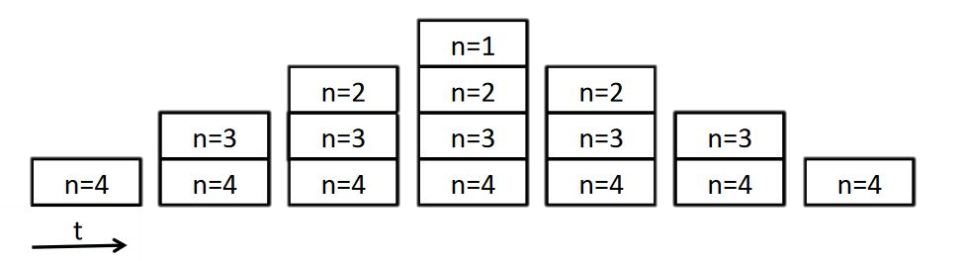
Practical Examples
If you’ve ever organized a school play, you probably used recursion! The big problem to solve would be setting up the play. But that alone is too difficult to immediately do! So, divide and conquer!
Break up your play into smaller problems to solve. The first problem might be the stage! You try to set up the stage, but you need the props first. Divide this problem and conquer it!
You try to build the props, but first you need the decorations and theme! Now once that issue has been simplified, you can solve each one in turn.
First, you create the decorations and theme, solving that problem. Then you are able to model the props, which solves that problem. Finally, you can solve that one bigger, initial problem of setting the stage!
By dividing and conquering each issue, you can solve the bigger problem!

Slide 5
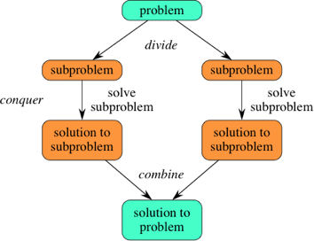
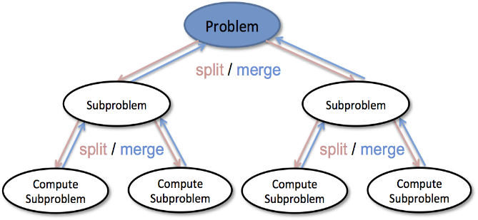
Practical Examples
When you do a literature essay, you can use recursion to help! The big picture is a finished essay, but you can divide and conquer!
First, you break it up into an introduction, a body, and a conclusion.
Second, you can divide that intro into an opening line and a thesis statement. From there, write your opener and thesis. With that, you finished the introduction to your essay!
Now, split the body into three different paragraphs, each with their own explanation on the topic.
You can divide those body paragraphs even further into claims, evidence, quotes, and analyses. Writing each of these components in one paragraph finishes one part of the body! Repeat this for the next two paragraphs and you completed the entire body of your essay!
Lastly, you can divide your conclusion into a summary and closing statement. After completing each part and combining them, you unwittingly finished your conclusion.
Finally, putting together the finished intro, body, and conclusion, you have a completed essay! #recursion

Slide 6
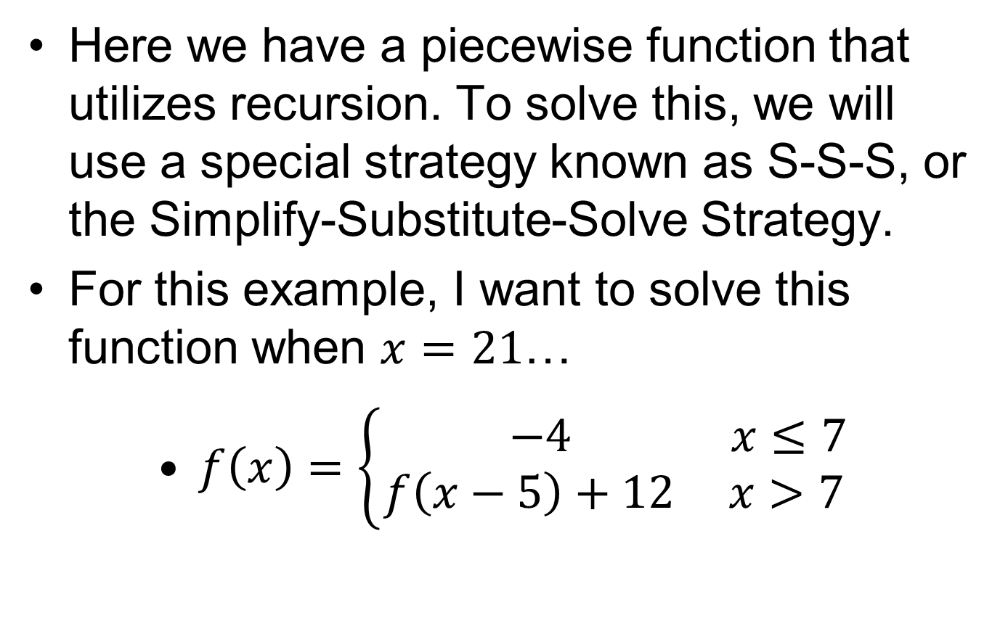
Recursion Example
Here we have a piecewise function that utilizes recursion. To solve this, we will use a special strategy known as S-S-S, or the Simplify-Substitute-Solve Strategy.
For this example, I want to solve this function when $x=21$…
$f\left(x\right)=\left\{\begin{aligned} −4 x≤7 \\ f\left(x−5\right)+12 x>7\end{aligned}\right.$

Slide 7
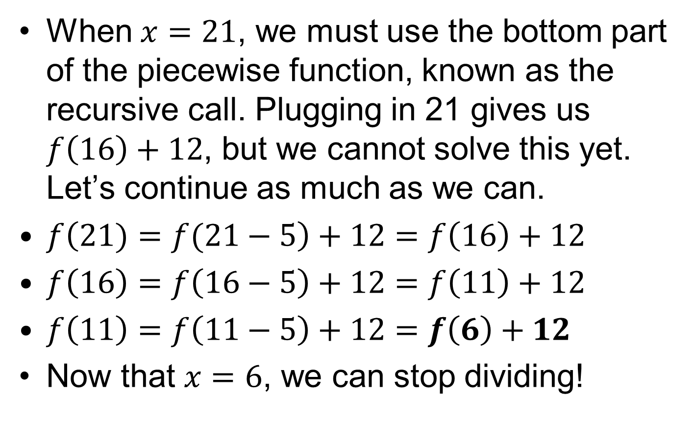
Simplify
When $x=21$, we must use the bottom part of the piecewise function, known as the recursive call. Plugging in 21 gives us $f\left(16\right)+12$, but we cannot solve this yet. Let’s continue as much as we can.
$f\left(21)=f(21−5\right)+12=f\left(16\right)+12$
$f\left(16\right)=f\left(16−5\right)+12=f\left(11\right)+12$
$f\left(11\right)=f\left(11−5\right)+12=f\left(6\right)+12$
Now that $x=6$, we can stop dividing!

Slide 8
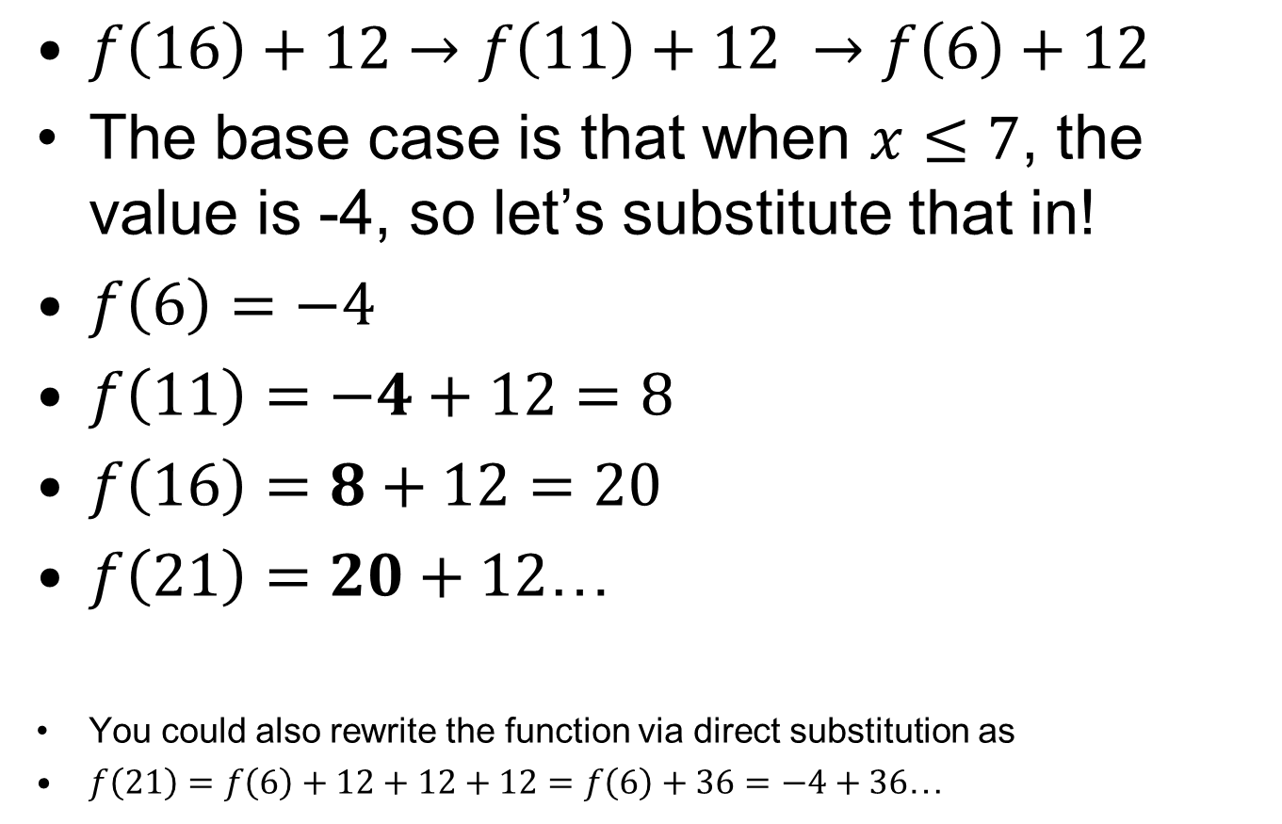
Substitute
$f\left(16\right)+12$ $→$ $f\left(11\right)+12 →f\left(6\right)+12$
The base case is that when $x≤7$, the value is -4, so let’s substitute that in!
$f\left(6\right)=−4$
$f\left(11\right)=−4+12=8$
$f\left(16\right)=8+12=20$
$f\left(21\right)=20+12$…
You could also rewrite the function via direct substitution as
$f\left(21\right)=f\left(6\right)+12+12+12=f\left(6\right)+36=−4+36$…

Slide 9


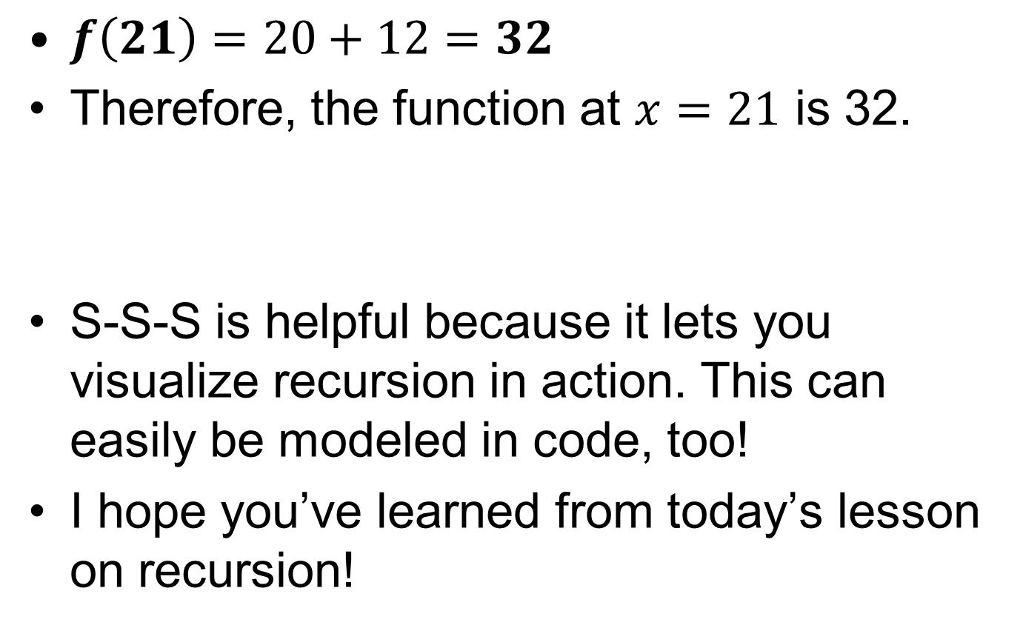
Solve!
$f\left(21\right)=20+12=32$
Therefore, the function at $x=21$ is 32.
S-S-S is helpful because it lets you visualize recursion in action. This can easily be modeled in code, too!
I hope you’ve learned from today’s lesson on recursion!

Slide 10
Recursion Presentation
by Paul Chafetz

